Slide 1
ORGAN CONNECT
“Let someone thank you”

Slide 2
Table of contents
01
02
03
04
05
06
Introduction
Why this project?
Problem
Statement
SQL TABLES
Implementation and features
Technologies
used

Slide 3
Hello and welcome!

Slide 4
INTRODUCTION & ABSTRACT
01

Slide 5
INTRODUCTION
Desperately waiting for an organ can feel like clinging to a thread of hope. Enter ORGAN CONNECT, your lifeline to connect directly with potential donors! This innovative platform cuts through inefficiencies, empowering patients to find lifesaving matches faster. Imagine, vital contact details just a message away, reducing wait times and saving precious lives. Dive deeper into this ethical, secure platform revolutionizing organ donation - witness inspiring stories, unveil unique features, and discover how YOU can be part of the change. Join us, let's rewrite the script, where hope blossoms into a second chance.

Slide 6
ABSTRACT
Thousands of lives are tragically lost each year due to the critical shortage of available organs for transplantation.
This problem stems from several key challenges, including inefficient data management, lack of public awareness, logistical complexities, and ethical concerns surrounding the donation process

Slide 7
02
PROBLEM STATEMENT
Notes:
A life-or-death gap exists in organ donation, fueled by a system hampered by manual processes, limited awareness, and outdated algorithms. Thousands perish while waiting for transplants, their hope fading amidst paperwork nightmares, undiscovered donors, and imperfect matches. Fragmented communication breeds confusion and distrust, while vulnerable data lacks security. This project proposes a revolutionary Organ Donation Management System (DBMS) to bridge this gap. By creating a user-friendly platform for registration and data management, the system empowers potential donors and streamlines information flow. Advanced matching algorithms prioritize compatibility and urgency for optimal organ allocation. Integrated communication tools facilitate real-time collaboration, and transparent reports and data visualizations build trust and guide informed decisions. Robust security measures protect sensitive data. This DBMS has the potential to dramatically improve the system, boosting donor registration, optimizing matching, fostering trust, and ultimately, saving lives.

Slide 8
PROBLEM STATEMENT
Organ donation gap widens as outdated system struggles with paperwork, low awareness, and subpar matching. Thousands die waiting, while potential donors remain undiscovered. Fragmented communication creates distrust, and data lacks security. This project proposes a revolutionary DBMS to bridge the gap, save lives, and offer hope.

Slide 9
03
Why this project?
We wanted to help society by managing the hospital data of organ donors so that no one who is in need of an organ dies because of lack of data.
we wanted to develop a website that connects donors with the hospitals like https://www.friends2support.org/

Slide 10
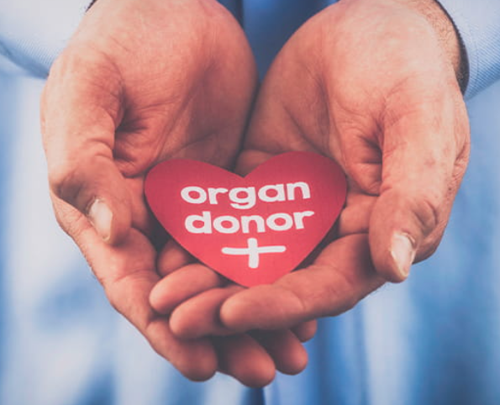
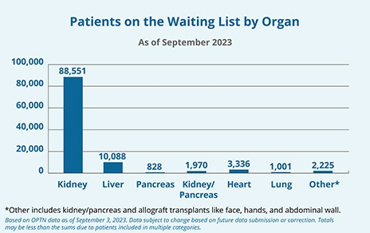
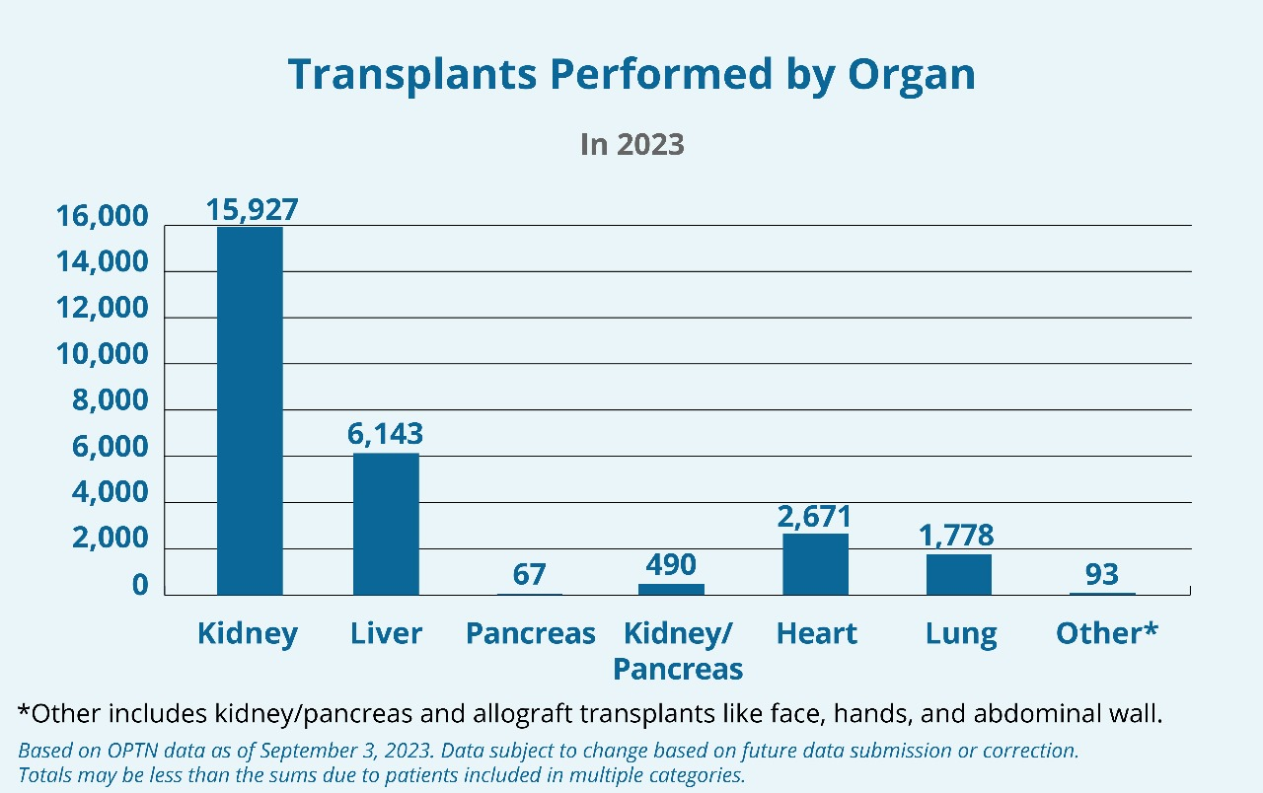
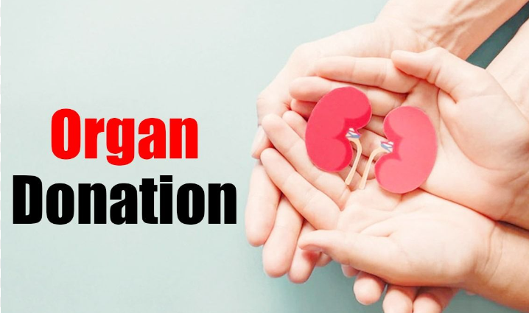

Slide 11
Implementation
04
Implementing a database management system that contains the data of donor and the required organs of the patient. Doctor details etc.,

Slide 12
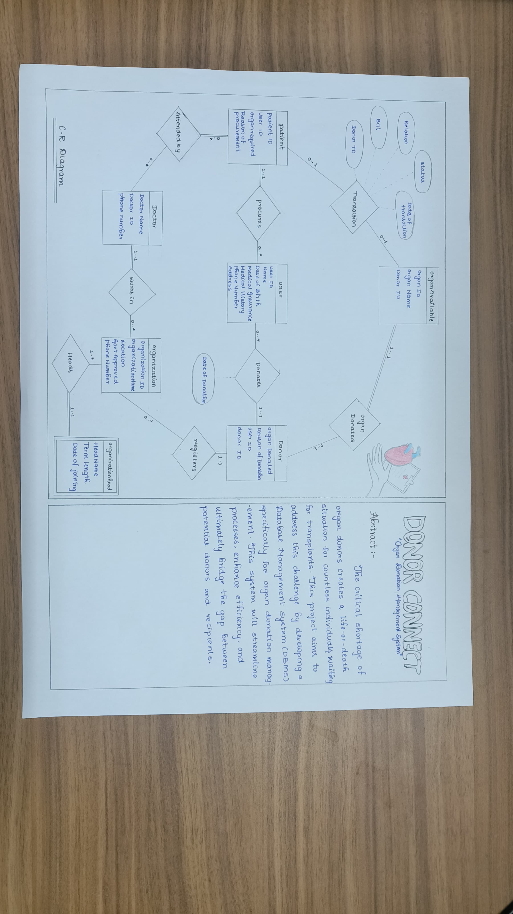
ENTITY–RELATIONSHIP DIAGRAM

Slide 13
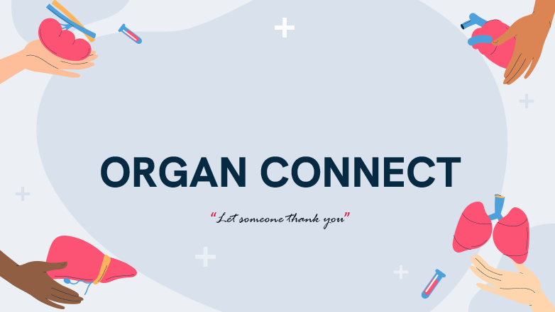
Our website link
http://127.0.0.1:5000

Slide 14

Organ donation process
Open website
If required
Organ connect
Tests are conducted and accepted donor
If healthy
Register as donor
Organs are donated based on donation type.
Get a call back from hospital based on requirement
Transplantation
Saturn is a gas giant and has several rings

Slide 15
05
Technologies used
PYTHON
SQL
HTML
FLASK

Slide 16
06
SQL TABLES

Slide 17
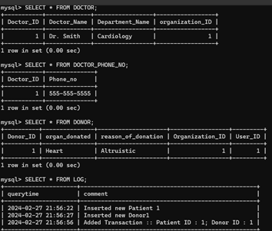

Slide 18
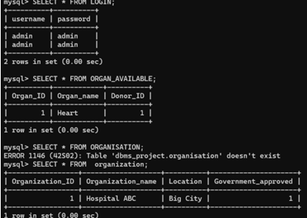

Slide 19
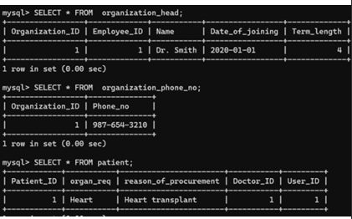

Slide 20
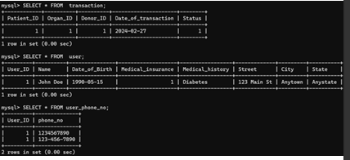

Slide 21
https://github.com/tarun360/Organ-Donation-and-Procurement-Network-Management-System
https://www.w3schools.com/python/python_mysql_getstarted.asp
https://www.organindia.org/ORGAN-DONATION/#:~:text=I%20feel%20that%20when%20a,their%20spirts%20and%20their%20confidence.

Slide 22
OUR TEAM
BANDI DILLI BABU REDDY
RA2211003011441
C S HARI CHANDANA
GUDIPATI SOWMYA
RA2211003011433
RA2211003011432

Slide 23
Thanks!

